Slide 1


Set and Maps Structures Slides by Adam Zweiger

Slide 2
Sets and Maps
In Java, there are two versions of sets and maps.
One uses sorting and the other uses hashing.

Slide 3
Sets
A set is a collection of objects with no duplicates.
An ordered set maintains the objects in sorted order.
Insertions, deletions, and searches are all O(log N), where N is the number of elements in the set.
In Java, the TreeSet class is an ordered set.
The add method inserts the element into the set if it is not already there.
The remove method deletes the element if it is there.
The contains method checks if the element is in the set.

Slide 4
More Operations
first(): returns the lowest element in the set
last(): returns the greatest element in the set
lower(a): returns the greatest element less than a
floor(a): returns the greatest element less than or equal to a
higher(a): returns the least element greater than a
ceiling(a): returns the least element greater than or equal to a

Slide 5
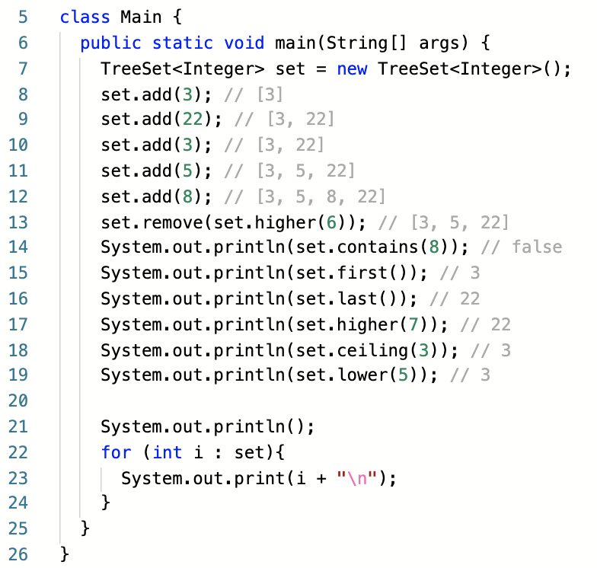
Sets Example
Notes:
https://repl.it/@AdamZweiger/set

Slide 6
Maps
A map is a collection of ordered pairs, each containing a key and a value.
Keys must be distinct, but values can be repeated.
Insertions, deletions, and searches are all O(log N), where N is the number of elements in the map.
In Java, the TreeMap class is an ordered map.
The put(key, value) method inserts the key and value pair into the map. If the key is already present, the value is still changed.
The remove(key) method deletes the map entry associated with the key.
The containsKey(key) method checks if the key is in the map.
The get(key) method returns the value associated with the key.

Slide 7
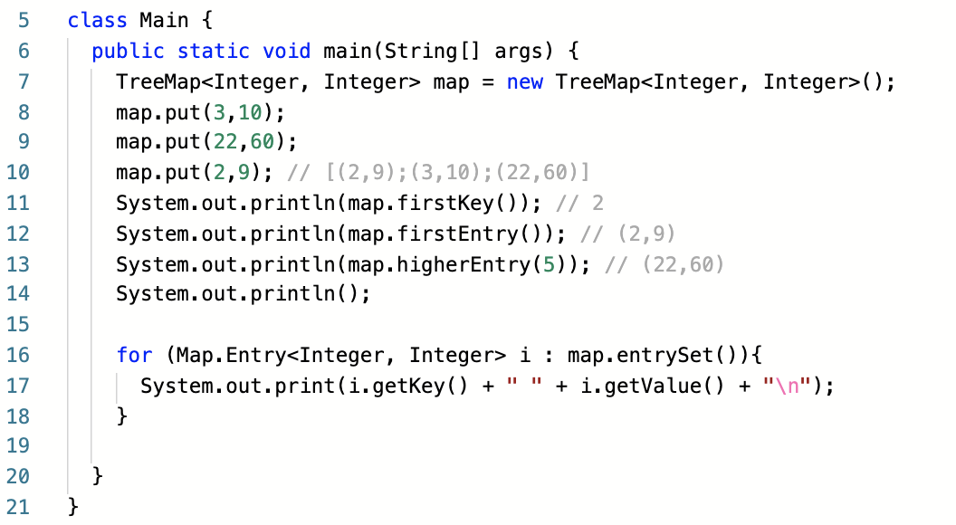
Maps Example
Notes:
https://repl.it/@AdamZweiger/map#Main.java

Slide 8
Multisets
A multiset is a sorted set that allows for multiple copies of the same element
In Java, there is no built in Multiset data structure, but we can implement one with TreeMap.
The first, last, higher, and lower operations still function as intended; just use firstKey, lastKey, higherKey, and lowerKey respectively.

Slide 9
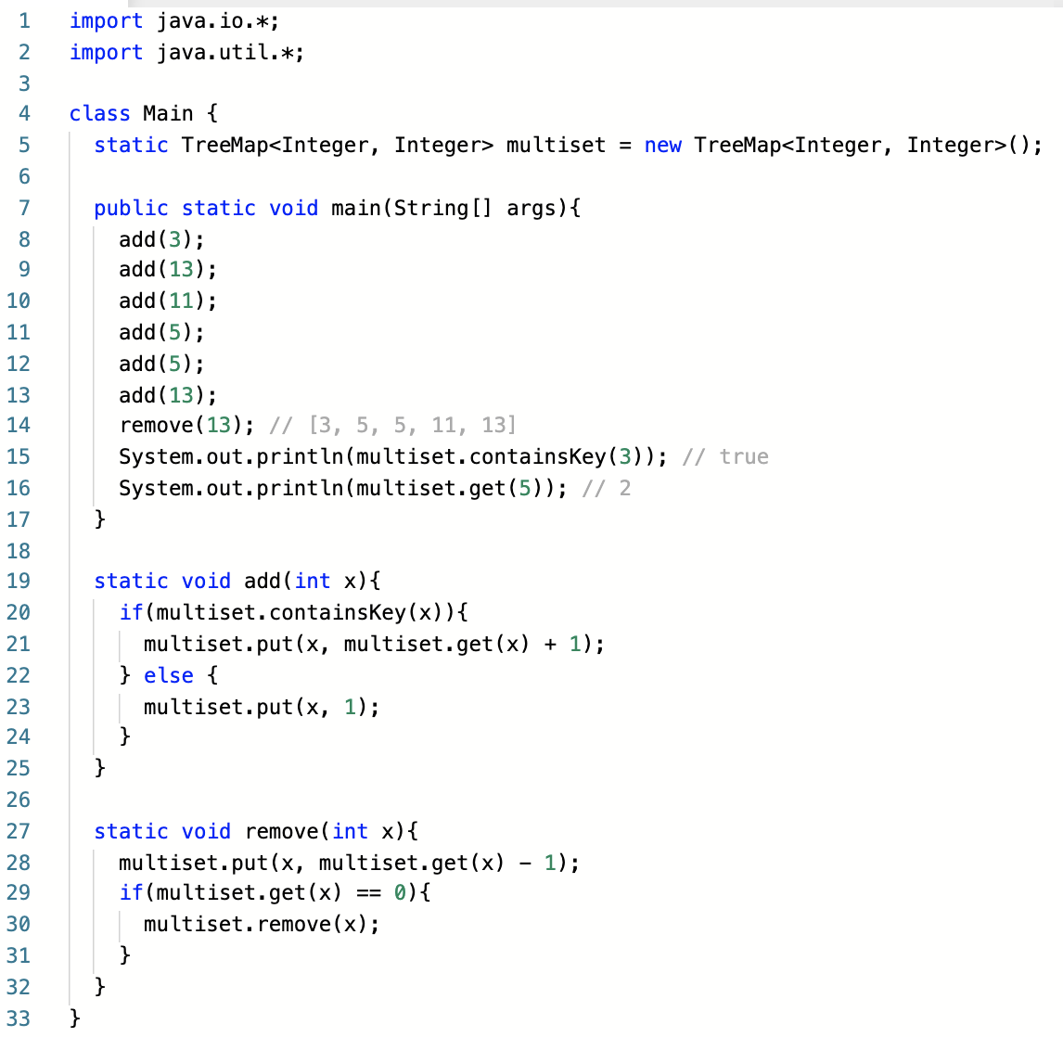
Multiset Example
Notes:
https://repl.it/@AdamZweiger/multiset#Main.java

Slide 10
Priority Queue(Heap)
Can insert elements, find element of highest “priority,” and delete element of highest priority, all in O(log N)
In Java, it’s actually elements of the lowest priority rather than highest
The add method inserts the element into the priority queue
The poll method deletes the element of lowest priority (the smallest element)
The peek method returns the element of lowest priority

Slide 11
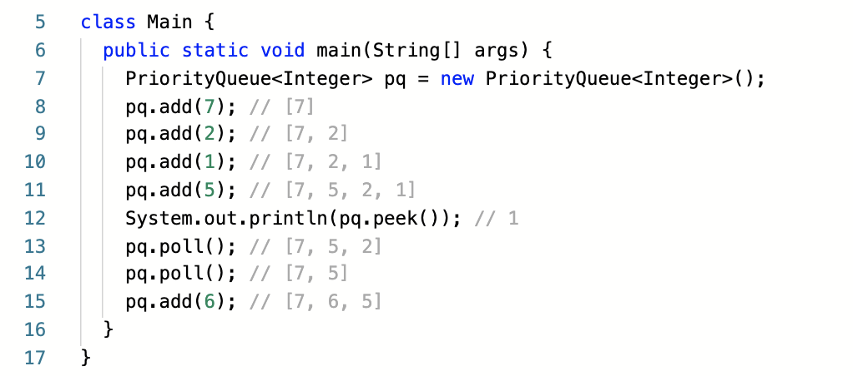
Priority Queue Example
Notes:
https://repl.it/@AdamZweiger/priorityqueue#Main.java

Slide 12
Problems
https://cses.fi/problemset/task/1091
http://www.usaco.org/index.php?page=viewproblem2&cpid=667
http://www.usaco.org/index.php?page=viewproblem2&cpid=763

